Slide 1

ICBP 2.0
Health Adda best Calorie Meal Assistance
Your Name : Chandika Mohan
Project GitHub Link: https://github.com/Chandikamohan/aihealth/upload/main https://github.com/Chandikamohan/aihealth/blob/main/geminiaifinal.py

Slide 2
Content
Problem Statement and Necessity
Objective
API Used
Model Architecture
Coding and Implementation
Results
References

Slide 3
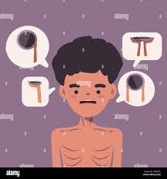
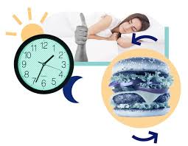
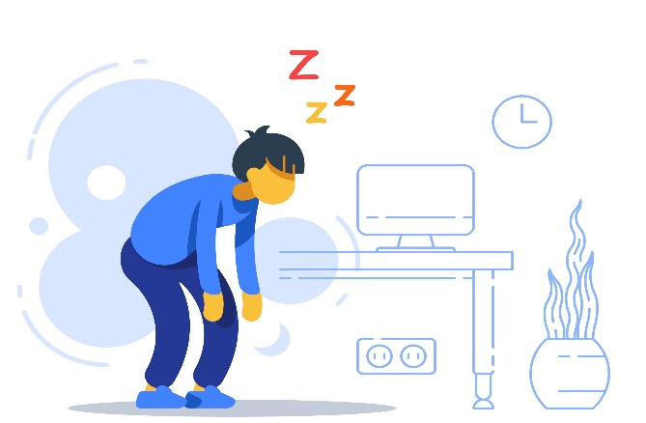
Problem Statement
Common Man: Thinks and retransform his knowledge from multiple sources for his work balance in this era. Lot of tools suggest Nutrition chart which are a wage and fail to understand the:
Conditions of age groups with average DNA History interms of height,weight and Medical histories
Working hours and Cultures of 24*7 needs, Sleeping Patterns
Lack of Time to adapt according to resources and Money
Personalized diet plans considering specific medical conditions, fitness goals, cultural preferences, and allergies.
Notes:
Need to discuss about :
What problem are you solving?
Why is it important?

Slide 4
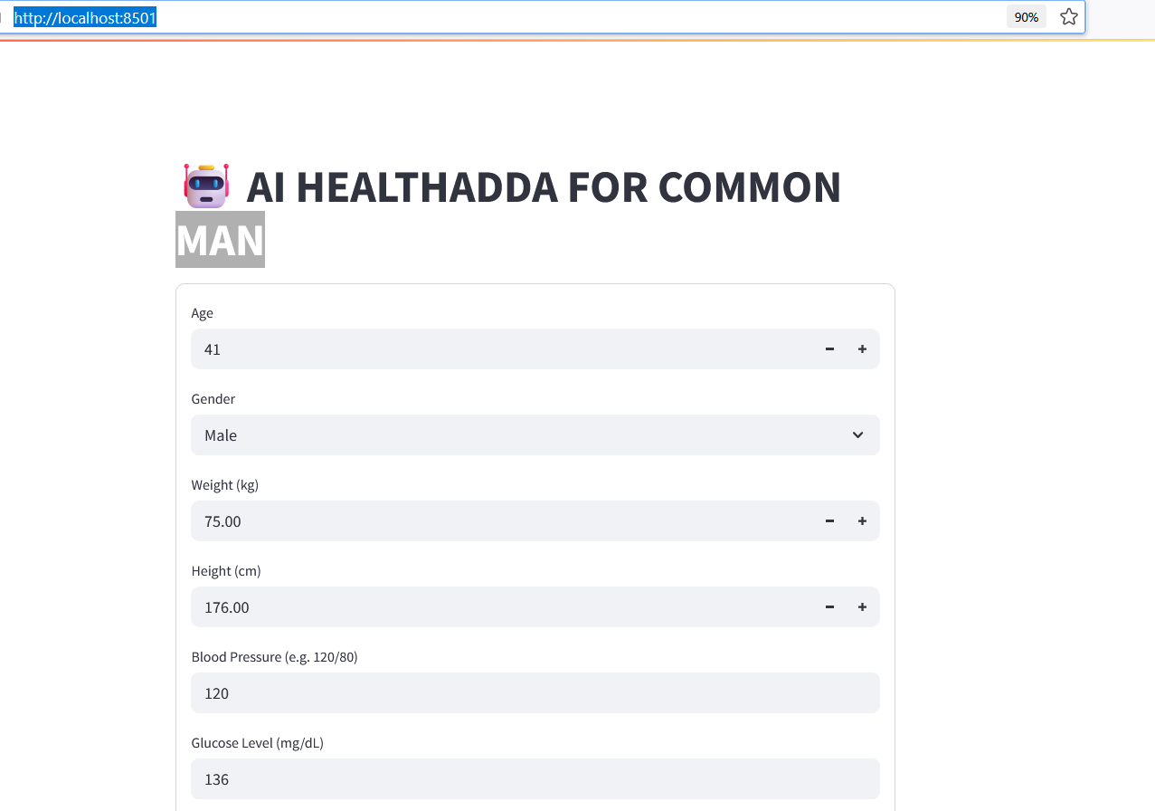
Model Solution using Gen AI-Healthadda for Common Man
AI Calorie Meal Assistant which takes input from user specific parameters and creates a practical meal according to timings and amount of calories to be intaken which can be Scalable, customizable, and ready for deployment.
Real-time interaction through a web app
Supported with Different models
Note: Refer the Reference
Notes:
Need to discuss about :
Visuals (graphs, images, etc.)
Comparison with baseline models (if any)
Inference speed, model size (for DL)

Slide 5
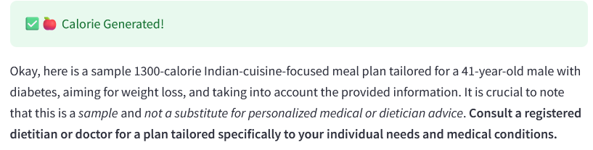
Objective
To build Gen API model which is adaptive according to given input prompt from the specific user text inputs
To provide personalized Calories meal recommendations based on health goals, preferences, medical conditions, fitness routines, and evolving user feedback..
Key Element attributes: age, weight, height, BMI, blood pressure, Diabetics,Gender, Target Variable
Provides optimized meal plans matching target nutritional goals with timings and type of food meal.
Notes:
Need to discuss about :
Clear goals of the project
What you aim to achieve with AI/ML/DL

Slide 6

System Architecture
Input UI → Streamlit
Backend API:
Google Generative AI
Prompt Engineering → Sends user health data targets
Response Handling → AI-generated Calorie plan returned for the day
Output Display → Supported web app http://localhost:8501/
Notes:
Need to discuss about :
Graphs, distributions, insights
Handling missing values, outliers, etc.

Slide 7
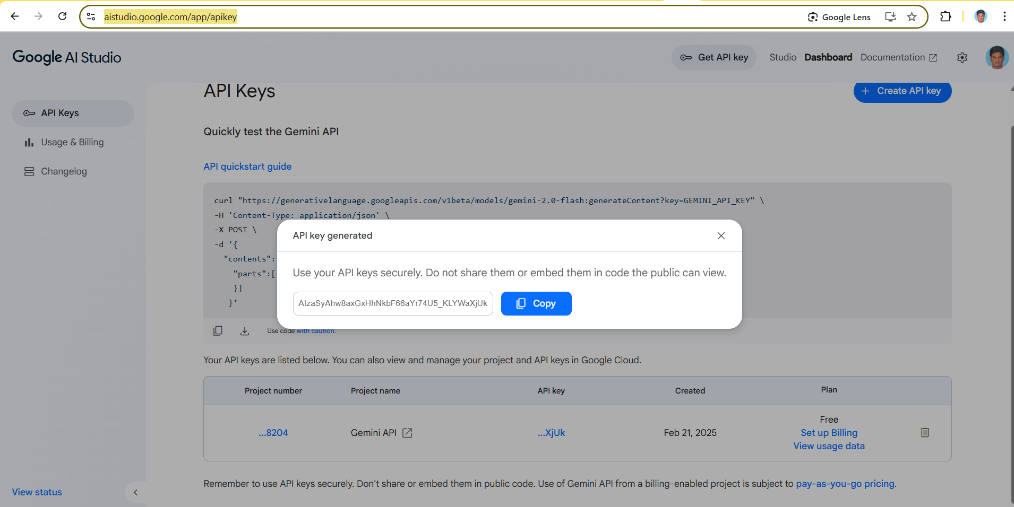

Slide 8
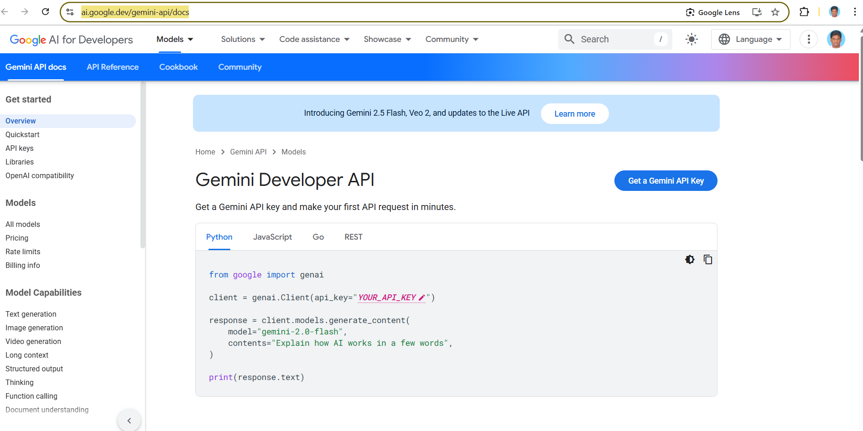

Slide 9
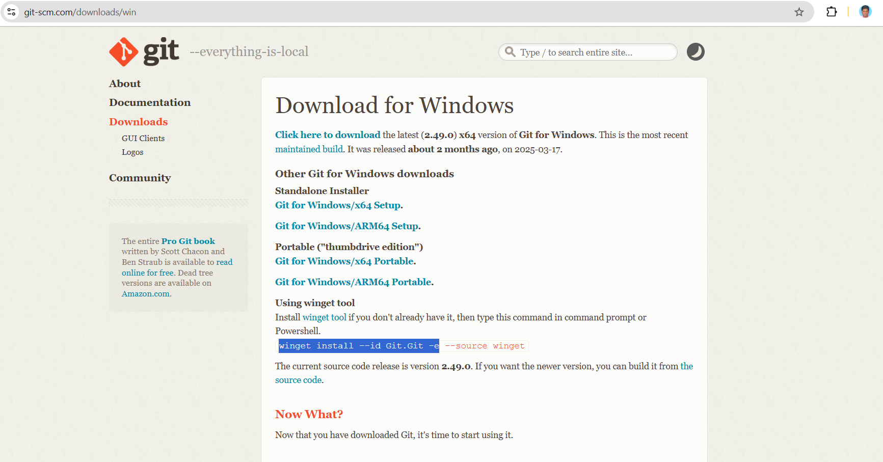

Slide 10
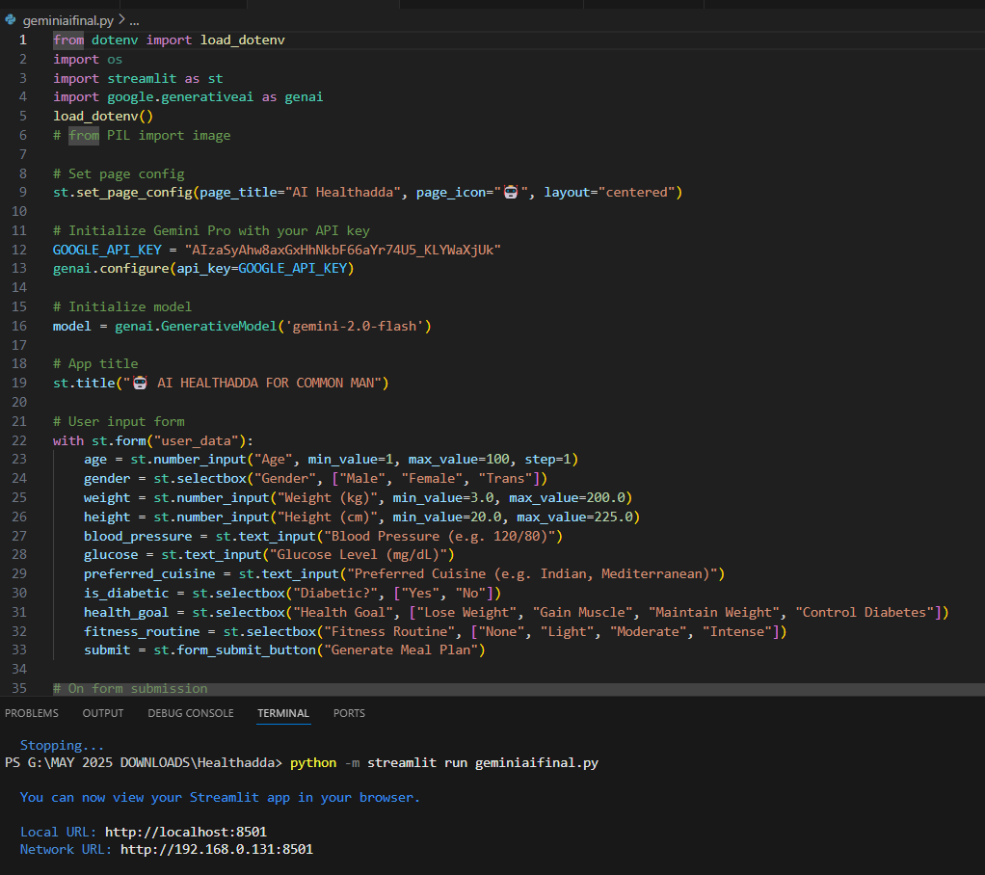
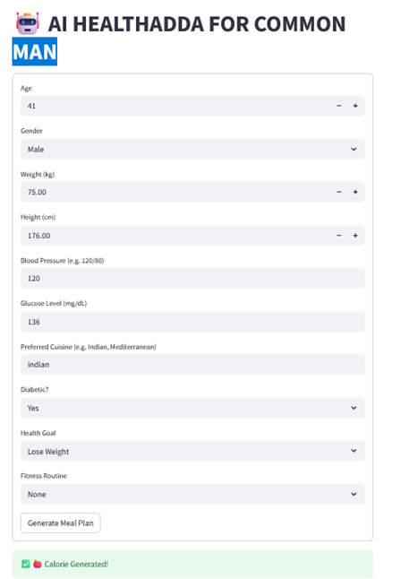

Slide 11
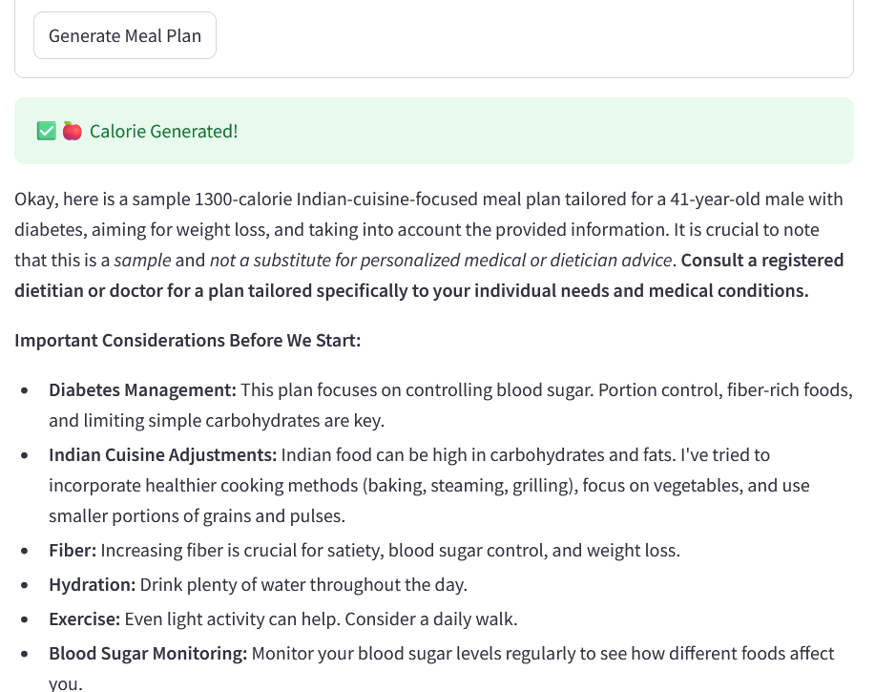
Prompt given to the model
Based on the following user information, suggest a healthy 1300 calories per day with FAT/FIBER/CARBS/PROTEIN for
Pre Breakfast,
Breakfast,
Mid Morning Snack,
Lunch,
Early Afternoon Snack,
Evening Snack,
Dinner
Predicted time and Type of food is suggested

Slide 12
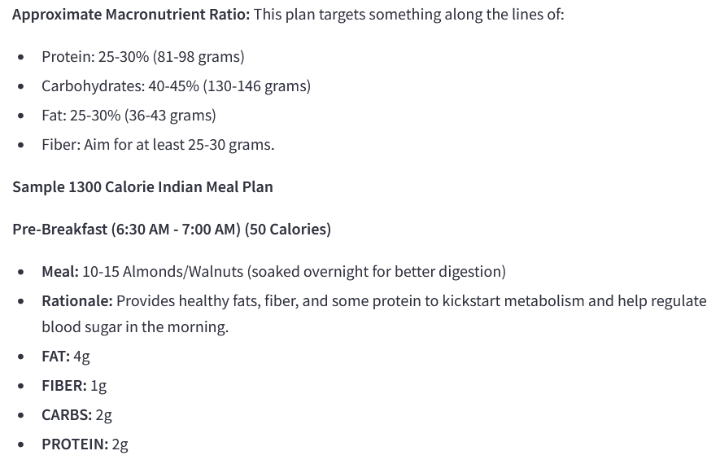

Slide 13
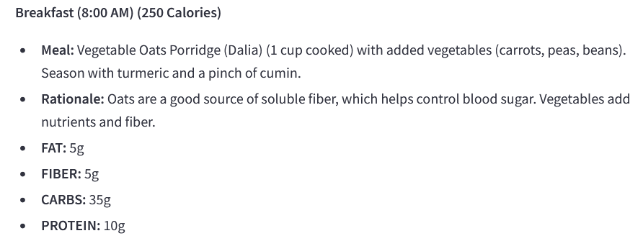
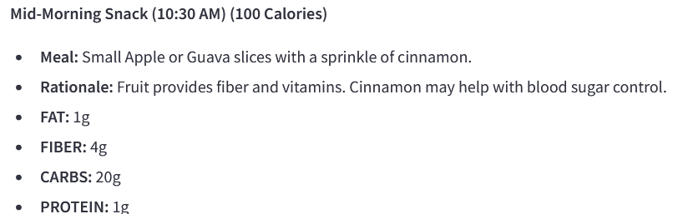

Slide 14
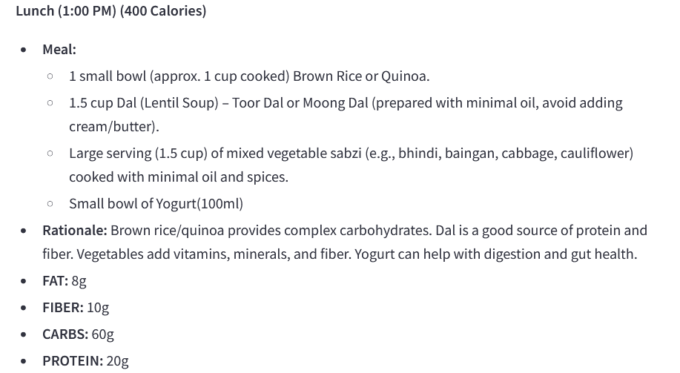

Slide 15
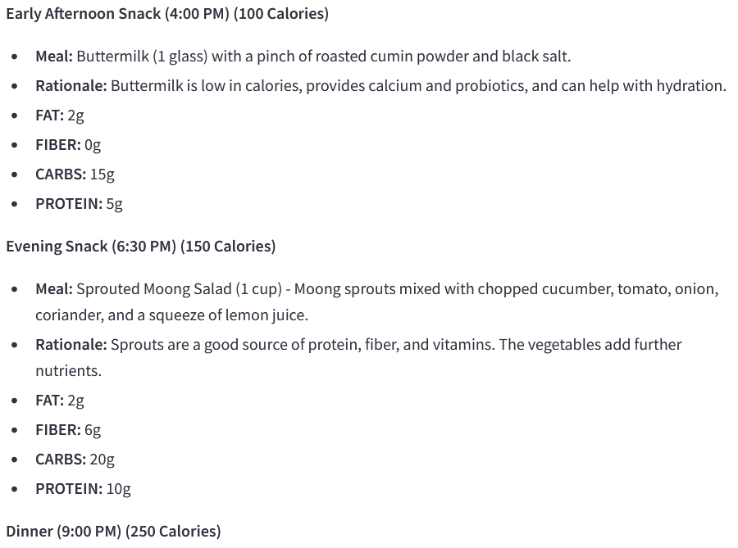

Slide 16
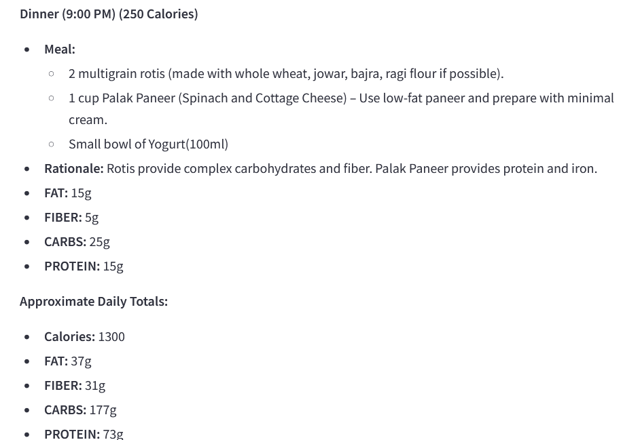

Slide 17
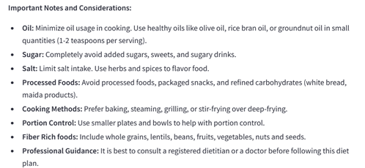
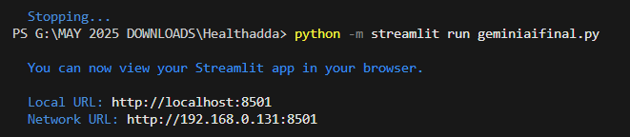
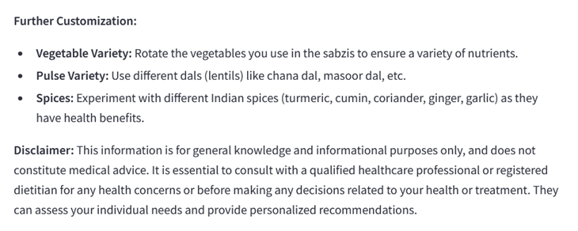

Slide 18
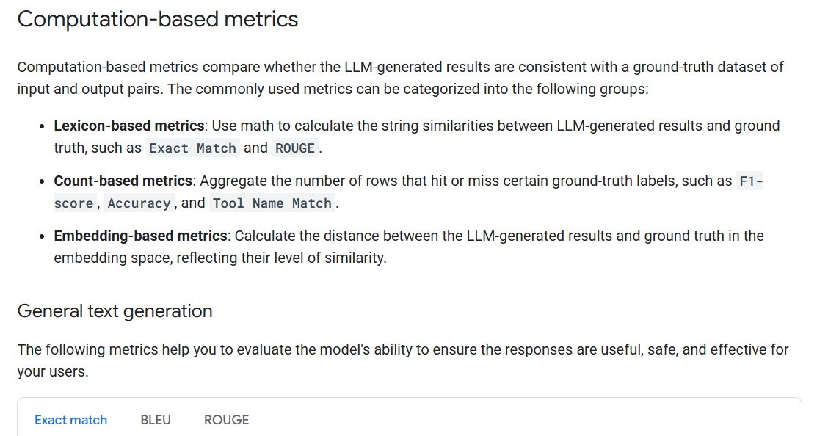

Slide 19
References
Vscode: https://code.visualstudio.com/docs/getstarted/getting-started
Streamlit: https://docs.kanaries.net/topics/Streamlit/streamlit-vscode
Google Generative AI Docs: https://cloud.google.com/vertex-ai/generative-ai/docs/models
https://ai.google.dev/gemini-api/docs
Prompt Enginering:
Google API: https://aistudio.google.com/app/apikey
WHO Dietary Guidelines: https://www.sugarfit.com/research/
Youtube channels
Notes:
Need to discuss about :
Papers, datasets, collaborators, tools used

Slide 20
Thank You

